Slide 1
PURCHASING
RESIDENT & EMPLOYEE
DISCOUNTED PARKING PERMITS
2022

Slide 2
Thank you for your interest in the discounted parking permit for the April-September season.
To purchase, please visit www.premiumparking.com/P2120 and follow the screenshot workflow in this instructional guide.
SUMMARY
Click on Season Permit
Enter email address or mobile phone number
Enter 4-Digit Verification Code
Enter license plate and payment details
Enter Promo Code Provided in the verification email sent by the Town, Click Add Promotion to discount price
When you see your price $20 for residents, $75 for employees, click Pay Now
Repeat for additional vehicles and use promo codes for discounts
Vehicle license plate is now registered in the digital Cloud Permit system and valid to begin parking immediately at any lot.
Vehicle license plates can not be edited once the payment has been made. To update your license plate, please email support@premiumparking.com
A license plate can only be edited once per season and the previous license will be deleted from the active license plate database.
Please abide by the time restricted parking spaces to avoid citations or immobilization.

Slide 3
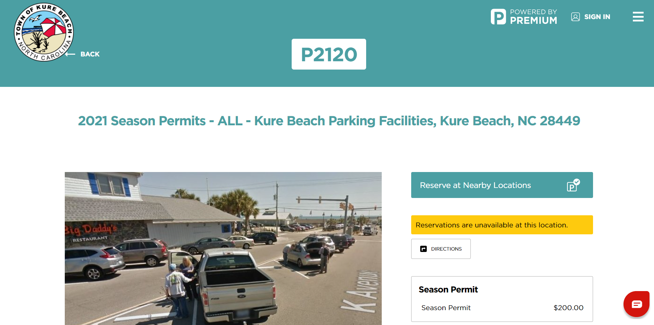
Select Season Permit
1

Slide 4
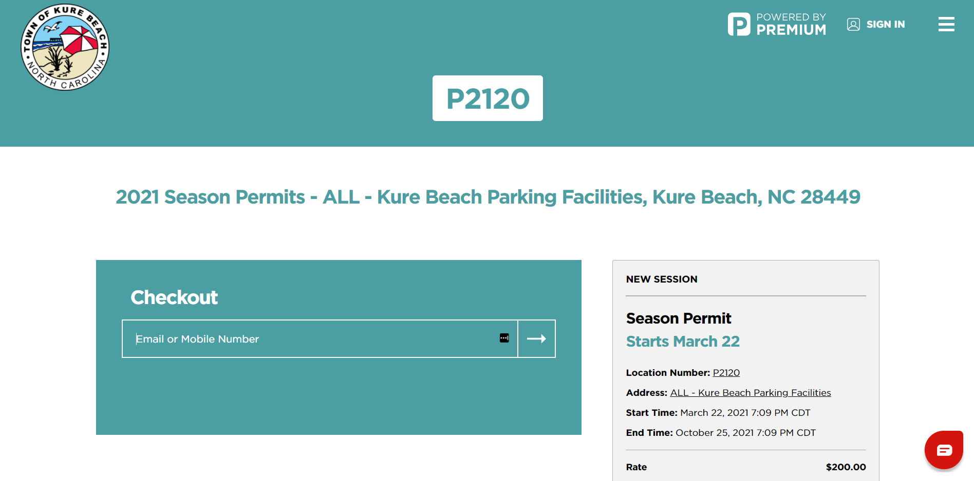
Enter Email or Mobile Number
2

Slide 5
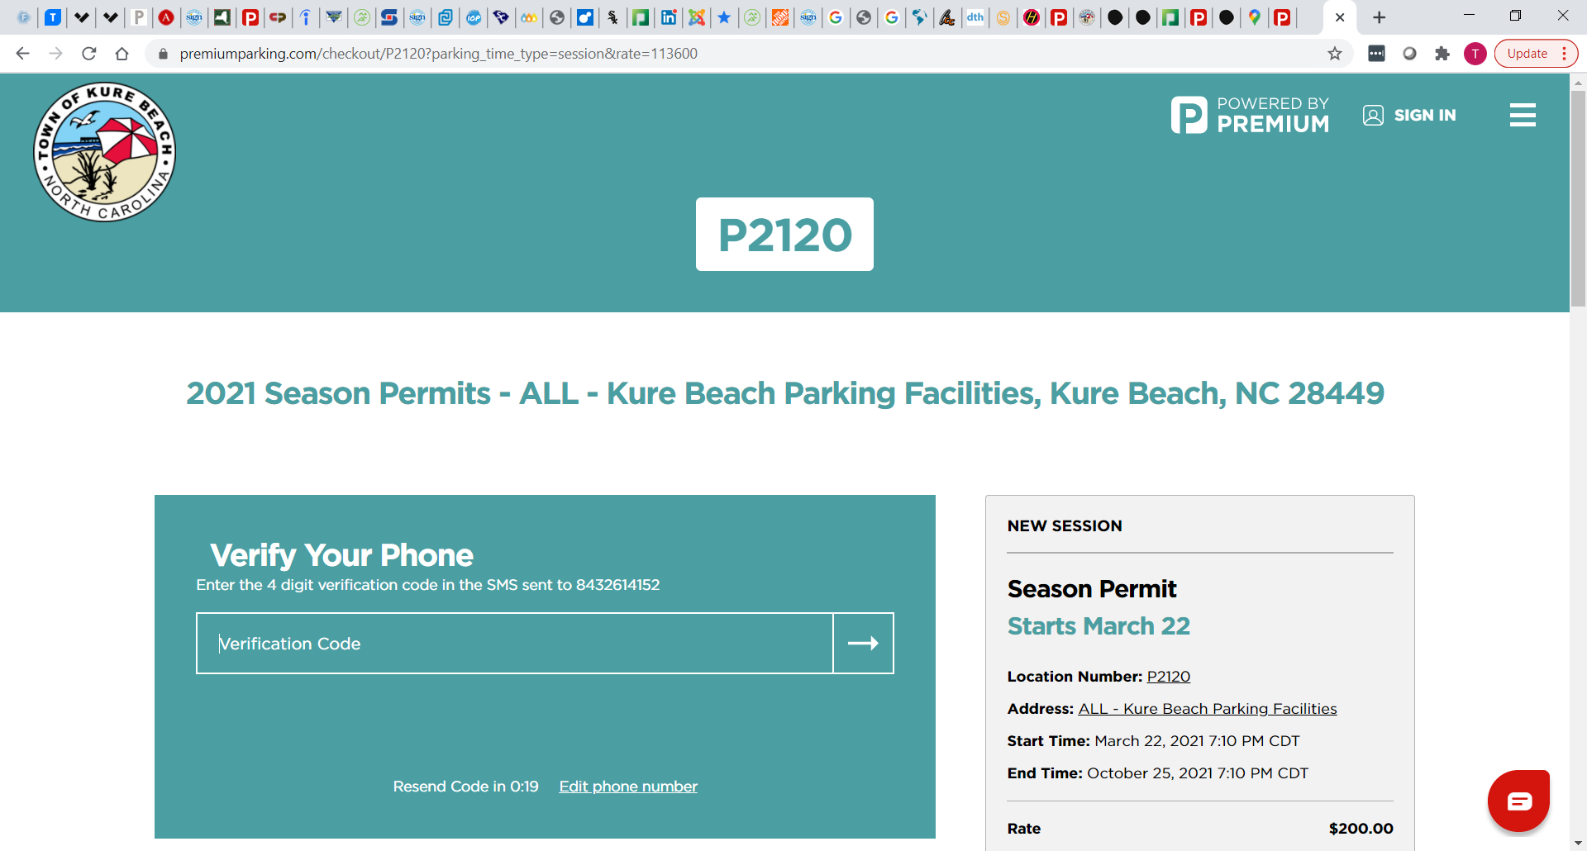
Enter 4 Digit Verification Code
3

Slide 6
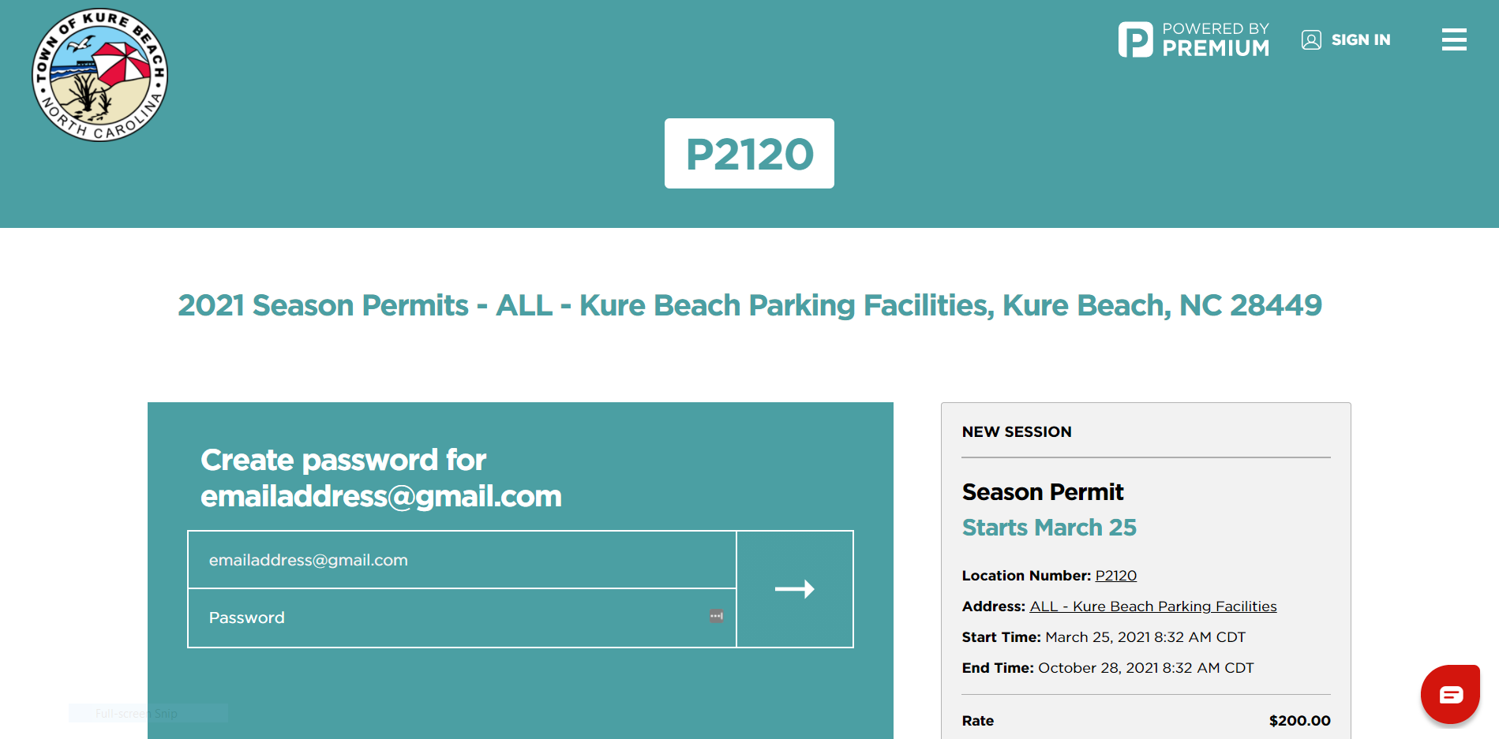
If you entered an email address, Create a password
Optional

Slide 7
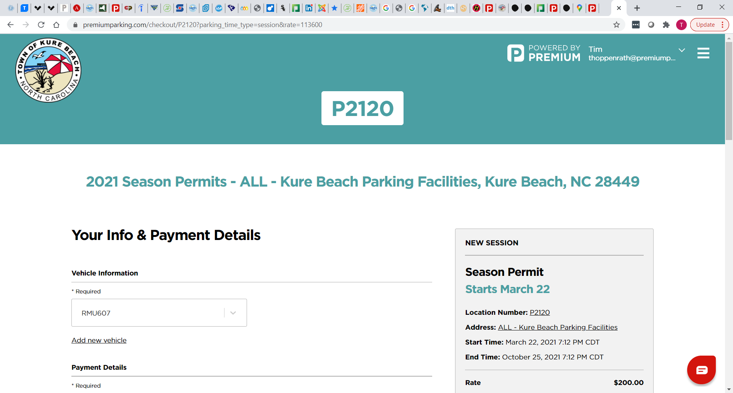
Enter License & Payment Details & Click “Have Promotion Code”
4
ABC 123
VISA xxxxx1234

Slide 8
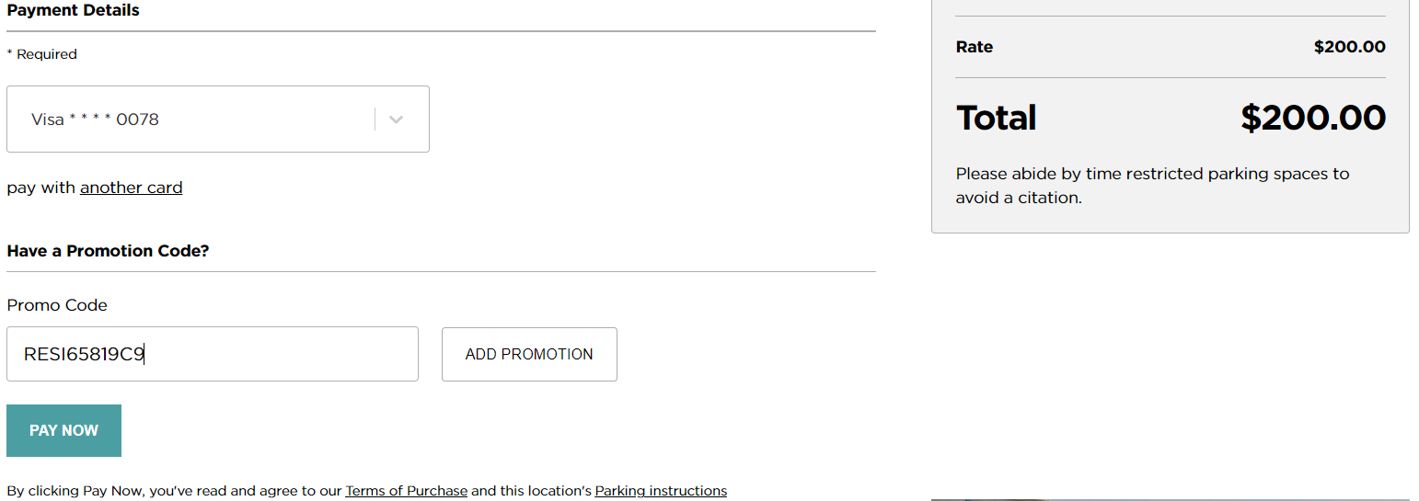
Enter Promo Code & Click Add Promotion
5
VISA xxxxx1234

Slide 9
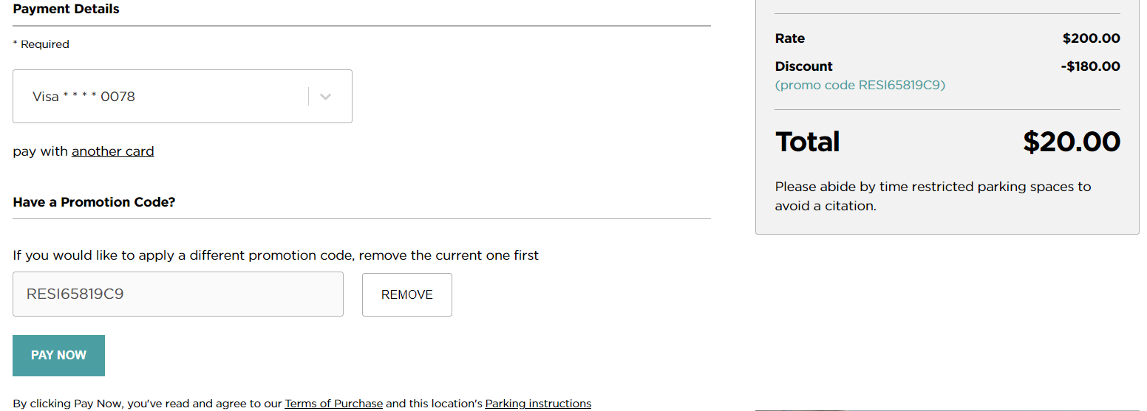
Rate will Discount to $20 & Click Pay Now
6
VISA xxxxx1234

Slide 10
Repeat for Each Vehicle
Vehicle license plate is now registered in the digital Cloud Permit system and valid to begin parking immediately.
Vehicle license plates can not be edited once the payment has been made. To update your license plate, please email support@premiumparking.com
A license plate can only be edited once per season and the previous license will be deleted from our system.
Please abide by the time restricted parking spaces to avoid citations or immobilization.
For additional assistance, please call 1-844-236-2011

